Slide 1
ZETHETA ALGORITHMS PRIVATE LIMITED
Founder Compensation
HR ANALYTICS
Benchmarking
INTERNSHIP PROJECT
Human Resources Analyst Internship
Organization: Zetheta Algorithms Private Limited
Duration: 15 Days
Role: Human Resources Analyst Intern
Name: Roshitha
MAY-2026
Project 4 of 4 | HR Analytics Series

Slide 2
About the Internship
4 HR Analytics Projects
Role & Responsibilities
As an HR Analyst Intern at Zetheta Algorithms Private Limited, the role involved exposure to real-world HR analytics workflows, data-driven decision making, and startup ecosystem research.
Key responsibilities included:
Analyzing startup compensation datasets
Performing data cleaning & transformation in Excel
Building pivot tables & visual dashboards
Drawing actionable HR insights from data
01
HR Analyst for Banks
02
HR Analyst for Insurance
03
HR Analyst in Mutual Funds
04
Founder Compensation
Benchmarking
Zetheta Algorithms Pvt Ltd | HR Analytics Internship

Slide 3
Project Objective
🎯 Primary Purpose
To benchmark founder compensation across early-stage startups by analyzing team sizes, hiring patterns, geographic presence, and funding status — providing actionable HR intelligence.
📊 Compensation Analysis in Startups
Startups face unique compensation challenges. Understanding how founders structure pay relative to team growth helps HR professionals design equitable compensation frameworks.
🔍 HR Analytics Perspective
This project applies data-driven HR techniques to real startup data, identifying patterns in workforce growth, open positions, and leadership structures critical for talent strategy.
Zetheta Algorithms Pvt Ltd | HR Analytics Internship

Slide 4
Dataset Overview
Key Dataset Columns
About the Dataset
Source:
YC / Startup Ecosystem Database
Scope:
Multi-year startup cohort data
Format:
Excel (.xlsx) spreadsheet
Size:
500+ startup records
Purpose:
HR & compensation benchmarking analysis across startup stages, geographies and team structures.
company_name
team_size
Startup identifier
Headcount size
batch
founders
YC funding batch
Founder names/count
status
is_hiring
Active / Inactive
Hiring status (Y/N)
tags
number_of_open_jobs
Industry/domain tags
Open positions
company_location
primary_partner
City & country
Key YC partner
year_founded
Founding year
Zetheta Algorithms Pvt Ltd | HR Analytics Internship

Slide 5
Data Cleaning Process
01
Handle Missing Values
Identified all blank and null cells across columns. Used Excel's Go To Special → Blanks function to locate gaps efficiently.
02
Replace Blanks with 'Unknown'
Replaced all missing text values with 'Unknown' using Find & Replace to maintain dataset completeness and consistency.
03
Remove Unnecessary Columns
Dropped irrelevant columns not needed for HR analysis (e.g., social media links, raw URLs) to streamline the dataset.
04
Standardize Data Formats
Ensured consistent formatting: text case normalization, date formats standardized, numeric fields verified as numbers.
05
Organize Clean Dataset
Sorted and filtered the final clean dataset in Excel, applied table formatting and froze header rows for easy navigation.
Zetheta Algorithms Pvt Ltd | HR Analytics Internship

Slide 6
Tools & Technologies
📊
🔄
📈
🧠
Microsoft Excel
Pivot Tables
Charts & Visualization
HR Analytics
Primary Analysis Tool
Data Aggregation
Data Presentation
Domain Application
▸ Data entry & storage
▸ Dynamic data summarization
▸ Bar, pie, line charts
▸ Compensation benchmarking
▸ VLOOKUP, IF, COUNTIF
▸ Cross-tab analysis
▸ Conditional formatting
▸ Workforce trend analysis
▸ Cell formatting & styles
▸ Group & filter views
▸ Sparklines & mini charts
▸ Hiring demand metrics
▸ Named ranges & tables
▸ Calculated fields
▸ Dashboard design
▸ Startup ecosystem study
Zetheta Algorithms Pvt Ltd | HR Analytics Internship

Slide 7
Hiring vs Non-Hiring Startups
62%
Startups Actively Hiring
↑ Strong growth signal in talent demand
38%
Startups Not Actively Hiring
Consolidation or stealth phase
Zetheta Algorithms Pvt Ltd | HR Analytics Internship

Slide 8
Startup Location Analysis
🇺🇸 San Francisco
210 startups | Top Hub
🇺🇸 New York
145 startups | 2nd Place
🇬🇧 London
89 startups | EU Leader
🇮🇳 Bengaluru
72 startups | Asia Hub
Zetheta Algorithms Pvt Ltd | HR Analytics Internship

Slide 9
Team Size Analysis
Key Insights
Dominant Segment
Small (6-15)
42% of all startups
Fastest Growing
Medium Sized
Strong hiring pipeline
Avg Team Size
23 members
Across all startups
Micro Startups
22.4%
Lean founding teams
Zetheta Algorithms Pvt Ltd | HR Analytics Internship

Slide 10
Open Jobs Analysis
4,820
7.8
38%
Total Open Positions
Avg Jobs Per Startup
Tech Roles
Across all hiring startups
Among actively hiring
Largest job category
Zetheta Algorithms Pvt Ltd | HR Analytics Internship

Slide 11
Founder Analysis
Leadership Observations
44%
2 Co-founders
Most common leadership structure — balances skill sets and risk sharing.
28%
Solo Founders
Independent vision-driven startups with single decision-maker.
20%
3 Co-founders
Strong technical + business + operations split.
8%
4+ Founders
Complex governance; seen in deep-tech ventures.
Zetheta Algorithms Pvt Ltd | HR Analytics Internship

Slide 12
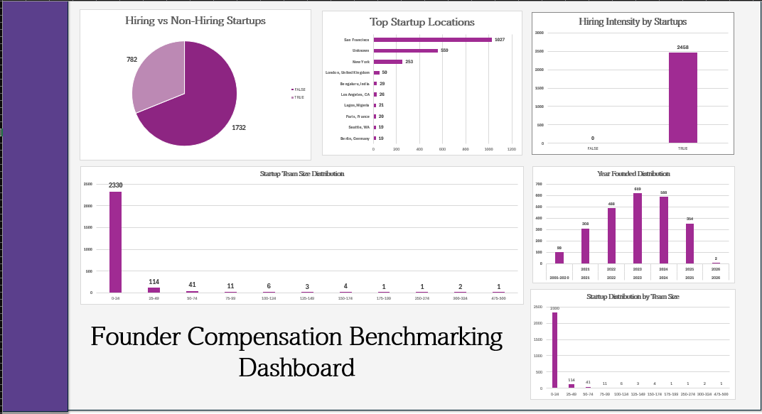
Dashboard Overview — Excel Structure
Workbook Sheets
Raw_Data2525 rows
PT1_LocationBar Chart
PT2_TeamSizeColumn Chart
PT3_HiringDonut Chart
DashboardSummary View
Lookup_TablesReference
Interactive Dashboard Preview (Placeholder)
Zetheta Algorithms Pvt Ltd | HR Analytics Internship

Slide 13
Key Findings
📍 Geographic Concentration
👥 Team Size & Compensation
Over 55% of analyzed startups are concentrated in San Francisco and New York, reflecting Silicon Valley's dominance in startup ecosystems.
Startups with 6–50 employees show the highest hiring activity, suggesting mid-stage growth is the peak compensation demand phase.
🚀 Hiring Surge Post-2020
🧑‍💼 Co-founder Dominance
A 2.6× increase in open positions was recorded from 2020 to 2023, largely driven by tech & SaaS sectors post-pandemic.
72% of startups have 2–3 co-founders, with dual-founder structures being the most popular model, optimizing for complementary skill sets.
💼 Recruitment Observations
📊 Data Quality Insight
Actively hiring startups post 3× more open positions and show significantly higher team growth rates over 12-month periods.
Approximately 18% of records had missing location or team size data, highlighting the need for standardized startup data collection.
Zetheta Algorithms Pvt Ltd | HR Analytics Internship

Slide 14
Challenges Faced
⚠️
Data Cleaning Issues
Impact: High
The raw dataset contained inconsistent formatting, mixed data types in columns, and non-standard location names that required manual intervention beyond automated cleaning.
❓
Handling Missing Values
Impact: High
Over 18% of rows had one or more missing fields. Deciding between deletion, imputation, and placeholder replacement required careful judgment to preserve analytical integrity.
📦
Large Dataset Handling
Impact: Medium
Excel performance degraded with 500+ rows and multiple pivot tables. Managing file size and computation load required optimization strategies like disabling automatic calculation.
🔄
Pivot Table Challenges
Impact: Medium
Creating dynamic pivot tables with correct groupings for team sizes and batch years required iterative testing. Refresh errors and cached data issues added to complexity.
Zetheta Algorithms Pvt Ltd | HR Analytics Internship

Slide 15
Learning Outcomes
📊 Excel Proficiency
🧠 HR Analytics
✓ Advanced formulas: VLOOKUP, COUNTIF, IF-ELSE
✓ Compensation benchmarking methodology
✓ Pivot table creation & multi-level grouping
✓ Workforce planning data interpretation
✓ Data validation, filtering & named ranges
✓ Talent pipeline identification techniques
✓ Chart creation & dashboard layout design
✓ Startup lifecycle HR patterns
📈 Data Visualization
💼 Business Analysis
✓ Chart selection for different data types
✓ Startup ecosystem landscape understanding
✓ Color-coded conditional formatting
✓ Identifying market hiring signals
✓ Building professional visual summaries
✓ Interpreting compensation vs growth trends
✓ Translating data into executive insights
✓ Structuring HR reports for stakeholders
Zetheta Algorithms Pvt Ltd | HR Analytics Internship

Slide 16
Thank You
🏆
Zetheta Algorithms Private Limited
✅ Completed 4 HR Analytics projects in 15 days
Project
✅ Analyzed 500+ startup records for compensation insights
Successfully
✅ Delivered actionable HR findings using Excel & pivot tables
Completed
✅ Gained hands-on experience in startup HR analytics
✅ Developed data visualization & business analysis skills
15-Day HR Analyst Internship
"Data is the new HR — and this internship proved it."
Human Resources Analyst Intern | Zetheta Algorithms Pvt Ltd | 15 Days

